Slide 1

AI Developer Productivity Analysis

Slide 2
Dataset Overview

Slide 3
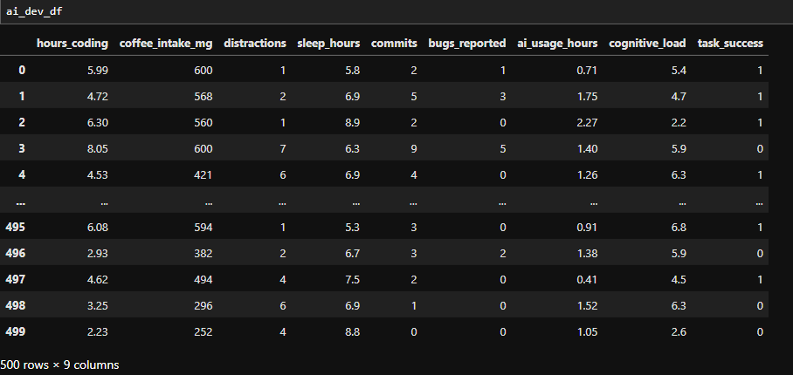
DataFrame Exploration
Rows & Columns: Checked using .shape
Data Types & Info: Used .dtypes and .info()
Observation:500
Features: 9

Slide 4
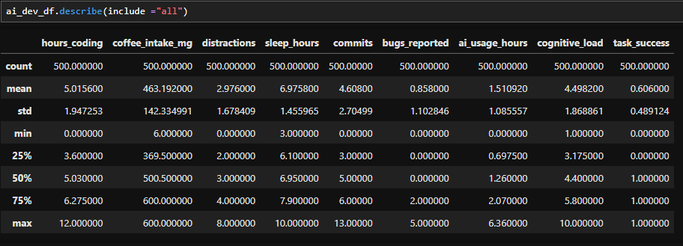
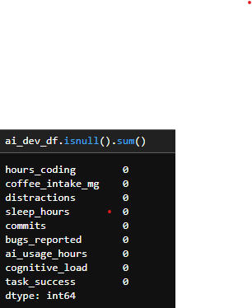
Basic Statistics :.describe(include="all")
Missing Values: .isnull().sum()—to check no null value

Slide 5
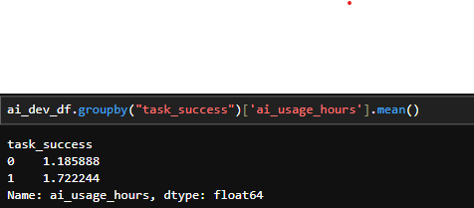
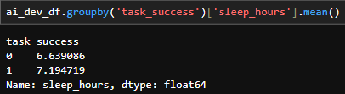
Key Insights & Grouped Analysis
AI usage vs Task Success
Sleep Hours
Successful developers tend to use AI more on average.
Task success is correlated with better sleep patterns.

Slide 6
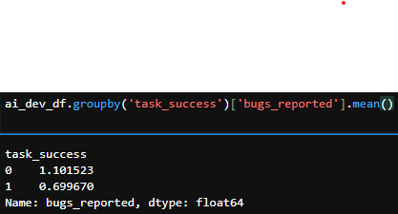
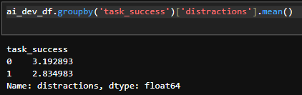
Coding Hours
Bugs Reported
More hours spent coding generally
align with higher task success.
I observed that failed tasks had a higher average number of bugs reported compared to successful ones
Distractions
I data shows that unsuccessful tasks are associated with a higher average number of distractions.

Slide 7
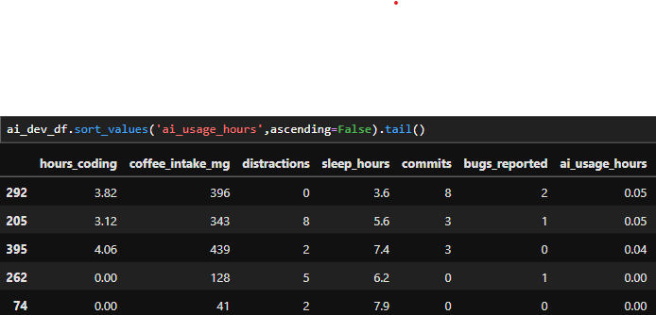
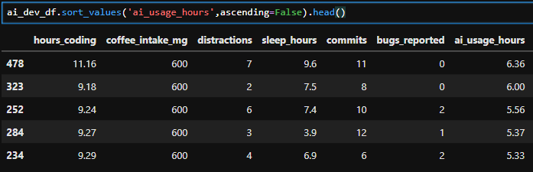
AI Tool Usage
Top 5 AI_Tools_Users
Top 5 AI_Tools_Users
Top AI users can be further analyzed for patterns (like higher success )
Developers who used AI tools more frequently had a higher average number of commits, indicating a positive correlation between AI integration and productivity.

Slide 8
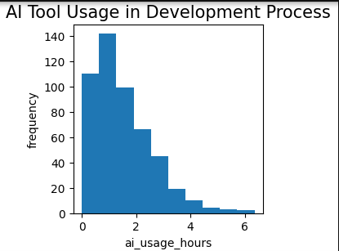
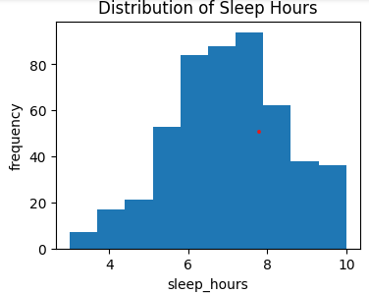
Histogram of AI usage and Sleep hours
Most developers use AI tools for 0 to 2 hours per day
Low AI usage is less common — indicating strong adoption
Majority of developers sleep between 6 to 8 hours
Very few sleep less than 5 hours or more than 9 hours
Adequate sleep is likely linked to better performance
outcomes

Slide 9
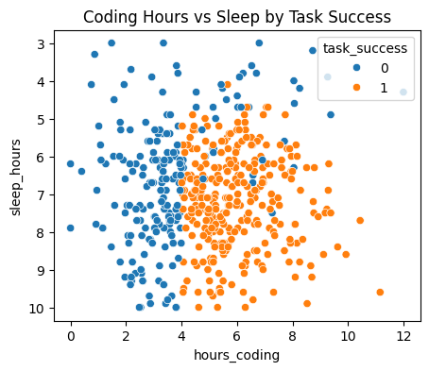
Developers with low sleep and high coding hours (top-left) showed more task failures
Successful tasks cluster around balanced sleep and coding hours

Slide 10
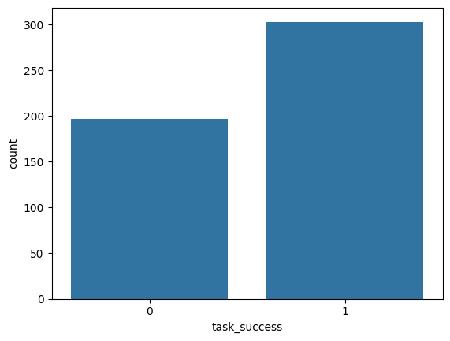
-axis: Task success status (0 = Failed, 1 = Successful)
CountPlot
X-axis: Task success status (0 = Failed, 1 = Successful)
Y-axis: Number of tasks in each category
Majority of tasks were successful
Fewer failures suggest effective practices or use of productivity tools

Slide 11
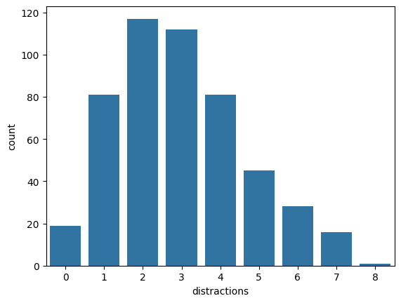
Highlights the most common distractions developers face
The tallest bars represent the biggest productivity blockers
This chart shows that distractions like noise, fatigue, and multitasking are frequently reported. These are key barriers to productivity and may impact task success if not managed well.
Frequency of Developer Distractions

Slide 12
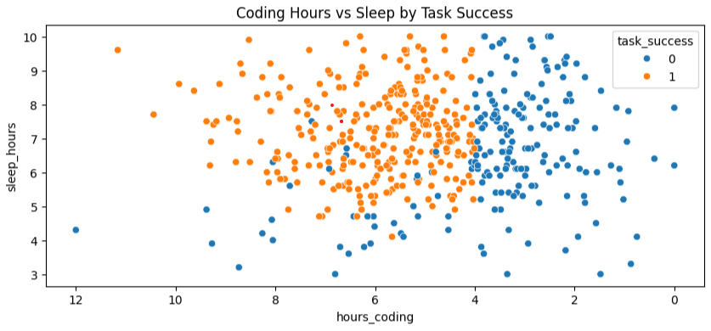
I flipped it → X-axis increases from right → left
High coding hours are now on the left
Low coding hours are on the right
Left side = people who code a lot
Right side = people who code less
Task_success= 1, Task_success=0
Overworking without enough sleep leads to more task failures. A balanced schedule — with enough sleep — Task_success.

Slide 13
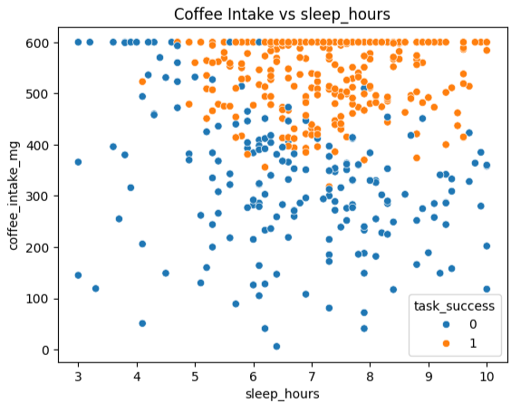
Developers who sleep less tend to consume more coffee
and Less sleep often leads to higher caffeine intake
High coffee + low sleep = more task failures
Success is more common with balanced sleep and moderate caffeine
Excessive caffeine might reflect fatigue and reduced effectiveness

Slide 14
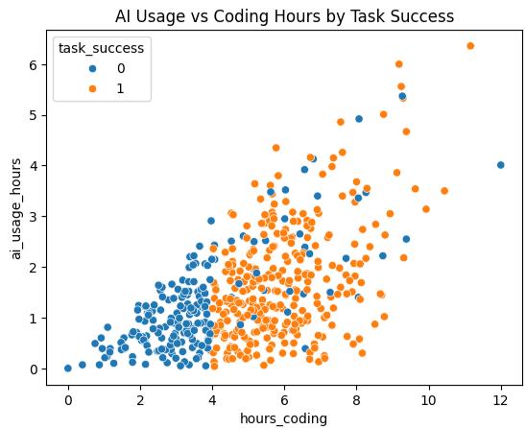
AI usage increases with longer coding hours
Successful tasks often involve moderate to high AI assistance
Shows that smart use of AI tools boosts productivity and outcomes
This plot shows a strong positive relationship between coding time and AI usage.
More importantly, successful tasks are most common
when developers use AI tools effectively. This suggests that AI doesn't just reduce effort.it actually improves task outcomes

Slide 15
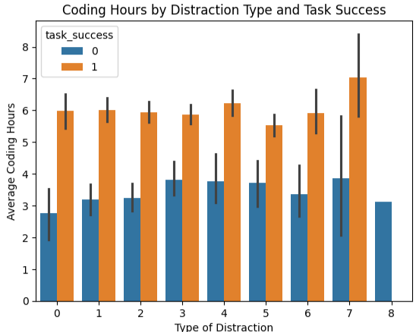
Socialmedia notification & multitasking lead to longer coding hours, but more failed tasks
Low-distraction environments show higher success with less coding time
Highlights the importance of focus and a healthy work environment
Not all time spent coding is productive-- distractions hurt output quality

Slide 16
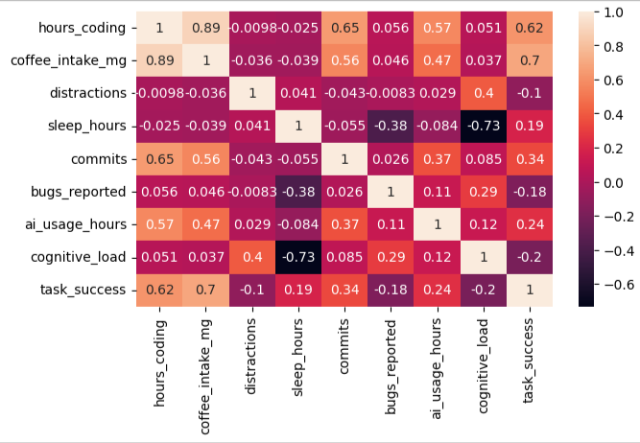
Shows how developer habits are interconnected
High coding hours relate to high caffeine and low sleep
Higher AI usage correlates with more successful tasks
Distractions and fatigue negatively impact task success
High coding time is strongly tied to coffee intake
Rest and focus reduce caffeine needs and improve outcomes

Slide 17
Conclusion
Balanced sleep is strongly linked with task success
AI usage has a positive impact on productivity and successful task completion
Distractions (like notification or multitasking) increase coding hours but reduce success
High coffee intake and long coding hours often lead to more failures
The correlation heatmap confirms that healthy work habits and tech usage together improve outcomes
"It’s not just how long developers work, but how smartly and healthily they work. Tools like AI, sufficient rest, and reduced distractions play a bigger role in productivity than raw effort alone."

